Slide 1

Applied Use Cases of the Health-RI Semantic Interoperability Initiative
Pedro Paulo F. Barcelos, Niek van Ulzen, Reinier Groeneveld,
Ana Konrad, Douwe Spaanderman, and Shuxin Zhang
Notes:
Welcome. In this presentation, I will walk you through applied use cases from the Health-RI Semantic Interoperability Initiative.
The focus is on how semantic technologies can support practical decisions in health data reuse. Rather than discussing interoperability in the abstract, we will follow concrete user stories and show how meaning can be made explicit, compared, validated, and reused across datasets.

Slide 2

Amir Hassan: Research Goal and Challenge
Amir is studying whether treatment outcomes differ across patient groups and needs to stratify his cohort using the correct sex/gender-related variable.
Before requesting data, he must identify which datasets contain the right variable for his study.
Dr. Amir Hassan — Researcher
Notes:
We begin with Amir’s perspective.
Amir is studying whether treatment outcomes differ across patient groups. To do that, he needs to stratify his cohort using the correct sex- or gender-related variable.
At first, this may sound straightforward. Many datasets contain variables that appear to describe sex or gender.
But before Amir can request and combine data, he needs to know which datasets contain the concept he actually needs, and whether similar variables are defined in the same way across institutions.
This is the central challenge: the labels may look familiar, but the underlying meanings may not be the same.

Slide 3
Amir’s End-to-End Workflow
Scenario 1
Scenario 2
Result
Scenario 3
Scenario 4
Notes:
This is Amir’s end-to-end workflow.
The workflow follows the steps Amir needs to take before he can make a defensible decision about data reuse. His goal is to move from label-based guessing to evidence-based interpretation.

Slide 4
Scenario 1: Clarify Meanings Before Reuse
Scenario 1: Clarify Meanings Before Reuse
Scenario 2
Result
Scenario 3
Scenario 4
Notes:
We now move into the first applied scenario: clarifying meanings before reuse.
This is the starting point for Amir’s work. Before selecting or combining any datasets, he needs to understand the landscape of related concepts.
Although sex- and gender-related variables may appear similar at first glance, they can be based on very different aspects of a person’s identity or record, including biological characteristics, social identity, legal status, or the perspective of the person or institution defining the information.
At this step, Amir is trying to understand what is out there: which sex- and gender-related meanings are represented in the available datasets, how they differ from one another, and which one best matches what he needs for his study.

Slide 5
Scenario 1: Amir’s Question and Challenge
What Amir wants
Use the correct sex/gender-related variable to create a cohort that can support trustworthy analysis.
Amir’s challenge
Similar-looking variables across datasets may represent different meanings, making reuse risky.
Guiding question
How can Amir avoid risky reuse when similar-looking variables may represent different meanings?

Slide 6






Available Sex and Gender Variables by Dataset
patient_id | care-sm:Sex ("Biological sex"@en) | birth_year | residence_code
NPR-001 | female | 1987 | 0363
NPR-002 | male | 1979 | 0599
NPR-003 | female | 1994 | 0518
NPR Demographic Extract
person_id | hri-openehr:legal-gender ("Legal gender"@en) | encounter_id | record_date
NMC-001 | female | ENC-7001 | 2026-01-14
NMC-002 | male | ENC-7002 | 2026-01-15
NMC-003 | nonbinary | ENC-7003 | 2026-01-16
Hospital Registration Extract
intake_id | loinc:107454-1 ("Administrative gender"@en) | questionnaire_id | submitted_date
RPCC-001 | woman | GIQ-001 | 2026-02-03
RPCC-002 | man | GIQ-001 | 2026-02-03
RPCC-003 | non-binary | GIQ-002 | 2026-02-04
Administrative Intake Extract
Scenario 1
Notes:
On this slide, Amir sees three illustrative dataset options. They are fictional examples, created to make the scenario realistic while keeping the focus on the semantic problem.
The first is the NPR Demographic Extract. We can think of this as a dataset owned by a national population registry, created to support demographic identification and population-level linkage. This dataset uses the Care-SM standard. The specific term used from that standard is care-sm:Sex, with the label “Biological sex.”
The second is the Hospital Registration Extract. This can be understood as a dataset owned by a hospital registration system, created to support patient registration and administrative handling during clinical encounters. This dataset uses an openEHR-based representation. The specific term used is hri-openehr:legal-gender, with the label “Legal gender.”
The third is the Administrative Intake Extract. This can be understood as a dataset owned by an intake or questionnaire service, created to collect information provided during administrative intake. This dataset uses LOINC. The specific term has label “Administrative gender.”

Slide 7
Labels and their Meanings
patient_id | care-sm:Sex ("Biological sex"@en) | birth_year | residence_code
NPR-001 | female | 1987 | 0363
NPR-002 | male | 1979 | 0599
NPR-003 | female | 1994 | 0518
NPR Demographic Extract
Same term. Do they share the same meaning?
person_id | hri-openehr:legal-gender ("Legal gender"@en) | encounter_id | record_date
NMC-001 | female | ENC-7001 | 2026-01-14
NMC-002 | male | ENC-7002 | 2026-01-15
NMC-003 | nonbinary | ENC-7003 | 2026-01-16
Hospital Registration Extract
What is the difference between ‘man’ and ‘male’?
intake_id | loinc:107454-1 ("Administrative gender"@en) | questionnaire_id | submitted_date
RPCC-001 | woman | GIQ-001 | 2026-02-03
RPCC-002 | man | GIQ-001 | 2026-02-03
RPCC-003 | non-binary | GIQ-002 | 2026-02-04
Administrative Intake Extract
Can these terms be used interchangeably?
Can he integrate and analyze these datasets together?
Scenario 1
Notes:
This slide highlights the problem with relying on labels alone.
We see terms such as female appearing in more than one dataset. But the same term does not necessarily carry the same meaning in every context.
For example, the term female in a biological sex column may not be equivalent to female in a legal gender column.
We also see related terms such as man and male. These may look close, but they do not necessarily refer to the same concept.
This highlights an important distinction: there is the value itself, and there is the meaning of the column in which that value appears.
So the key question is not just whether labels match, but whether the underlying concepts align.
This is where precise and explicit definitions become essential for responsible and reproducible data reuse.

Slide 8




The Health-RI Conceptual Ontology
The Health-RI Semantic Interoperability Initiative
1
Conceptual clarification:
Meanings are precise and explicit
HRIM
Mapping Set
HRIO
Conceptual
HRIO
Computational
Scenario 1
Notes:
To support this kind of clarification, we use HRIO: the Health-RI Ontology.
HRIO makes the variables’ intended meanings precise and explicit, using OntoUML: a modeling language designed to describe concepts and their relationships in a clear and unambiguous way.

Slide 9
Similar Variables, Different Meanings
 | care-sm:Sex ("Biological sex"@en)
 | female
 | male
 | female
 | hri-openehr:legal-gender ("Legal gender"@en)
 | female
 | male
 | nonbinary
 | loinc:107454-1 ("Administrative gender"@en)
 | woman
 | man
 | non-binary
The variables may look comparable, but they are linked to different meanings and should not be treated as interchangeable.
Scenario 1
Notes:
We now return to the dataset variables from Amir’s scenario.
The variables may still look comparable because they contain familiar values such as female, male, woman, man, and non-binary.
But after Amir uses HRIO to identify the intended meaning of each variable, their differences become clear.
One variable is about biological sex. One is about legal gender. One is about administrative gender.
So the conclusion for this first scenario is clear: Amir should not treat these variables as interchangeable just because their labels or values look similar.
By making the meanings explicit, he can avoid label-based guessing and move toward a more defensible decision about which data can be reused for his study.

Slide 10
Scenario 2: Identify the datasets that represent the right meaning
Scenario 1: Clarify Meanings Before Reuse
Scenario 2: Identify the datasets that represent the right meaning
Result
Scenario 3
Scenario 4
Notes:
We now move from Scenario 1 into Scenario 2.
In the first scenario, Amir clarified that sex- and gender-related variables can represent different meanings. In this scenario, he applies that understanding to a practical task: finding the dataset that contains the right variable for his study.
For Amir, the target meaning is biological sex. The question is no longer simply, “Which datasets contain a column whose label is related to sex?” The question is, “Which dataset contains the variable that represents biological sex?”

Slide 11
Scenario 2: Amir’s Question and Challenge
What Amir wants
Find the dataset column for biological sex so he can build a cohort that fits his research question.
Amir’s challenge
Several datasets appear relevant, but their sex/gender-related columns represent different meanings, making label-based selection unsafe.
Guiding question
Which dataset contains the variable that represents biological sex?

Slide 12
From Conceptual Clarity to Actionable Semantics
The meanings are now clear in the conceptual model, but Amir still cannot query over them directly.
The next step is to express these conceptual meanings as machine-processable relations, making them queryable and actionable.
hrio:Sex
hrio:LegalGender
hrio:AdministrativeGender
Meanings
care-sm:Sex
hri-openehr:legal-gender
loinc:107454-1
Standard Concepts
NPR Demographic
Extract
Hospital Registration
Extract
Administrative Intake
Extract
Dataset Columns
Scenario 2
Notes:
Back in Amir’s situation.
At this point, the relevant meanings are clear in the conceptual model. Amir can see which concepts represent biological sex, legal gender, or administrative gender.
However, this still leaves Amir with a practical limitation. The meanings are known, but they are not yet computationally actionable.
The next step is to turn these conceptual meanings into machine-readable, queryable, and actionable relations.

Slide 13
The Health-RI Computational Ontology
The Health-RI Semantic Interoperability Initiative
1
Conceptual clarification:
Meanings are precise and explicit
HRIM
Mapping Set
HRIO
Conceptual
2
Computational tractability:
Machine-readable relations
HRIO
Computational
Scenario 2
Notes:
In the previous scenario, we introduced HRIO as a way to support conceptual clarification. It helped make meanings precise and explicit. But we now move from conceptual clarification to computational tractability.
This is where the computational version of HRIO comes in. It represents the relevant meanings and their relations in machine-readable form, so they can be queried, processed, and reused.
In other words, the computational ontology turns conceptual distinctions into something that can support Amir’s dataset discovery task.

Slide 14
From Conceptual Clarity to Actionable Semantics
Amir can now query for dataset columns that are mapped to the meaning he needs: HRIO’s Sex.
input
hrio:Sex
hrio:LegalGender
hrio:AdministrativeGender
Meanings
SELECT DISTINCT ?output
WHERE {
VALUES ?input { hrio:Sex }
?mapping a demo:Mapping ;
demo:hasMappingSource ?concept ;
demo:hasTargetMeaning ?input .
?output demo:implementsConcept ?concept .
}
ORDER BY ?output
care-sm:Sex
hri-openehr:legal-gender
loinc:107454-1
Standard Concepts
NPR Demographic
Extract
Hospital Registration
Extract
Administrative Intake
Extract
Dataset Columns
output
Scenario 2
Notes:
We now reach the result of Scenario 2.
The meanings are now not only clear, but also computationally actionable. Amir can query for dataset columns that are mapped to the meaning he needs: biological sex, represented here as HRIO’s Sex.
In this example, the query returns the NPR Demographic Extract, because its column is mapped to the biological sex meaning.
So, Amir no longer has to rely only on labels or manual inspection. He can use explicit, machine-readable semantic relations to identify the dataset that contains the right variable for his study.

Slide 15
Scenario 3: Use Mappings to Connect Data and Infer Reuse Knowledge
Scenario 1: Clarify Meanings Before Reuse
Scenario 2: Identify the datasets that represent the right meaning
Result
Scenario 3: Use Mappings to Connect Data and Infer Reuse Knowledge
Scenario 4

Slide 16
Scenario 3: Amir’s Question and Challenge
What Amir wants
Apply reusable mappings to relate dataset variables, standard concepts, and explicit meanings.
Amir’s challenge
The meanings are explicit and machine-readable, but these relationships must be captured as reusable mappings.
Guiding question
How can mappings turn these relationships into reusable knowledge?

Slide 17
External Mappings
source_CURIE | source_label | target_CURIE | target_label
cdisc-sdtm:DM.SEX | Sex | care-sm:Sex | Biological sex
ncit:C28421 | Sex | care-sm:Sex | Biological sex
 | care-sm:Sex ("Biological sex"@en)
 | female
 | male
 | female
Clinical Research Standards Mapping Community
source_CURIE | source_label | target_CURIE | target_label
npr:person.sex_code | Registered biol. sex | care-sm:Sex | Biological sex
npr:person.sex_code | Registered biol. sex | registry:resident.sex | Resident sex
fhir:Patient.gender | Administrative gender | hl7v3:AdmGender | Administrative gender
 | hri-openehr:legal-gender ("Legal gender"@en)
 | female
 | male
 | nonbinary
Dutch Health Data Stewardship Community
 | loinc:107454-1 ("Administrative gender"@en)
 | woman
 | man
 | non-binary
source_CURIE | source_label | target_CURIE | target_label
loinc:107454-1 | Administrative gender | fhir:Patient.gender | Administrative gender
loinc:107454-1 | Administrative gender | hl7v2:0001 | Administrative sex
Administrative Gender Standards Community

Slide 18
Pairwise Mappings Require Multiple Steps
Without a meaning layer, reuse depends on chains of concept-to-concept mappings.
These mappings are often fragile and label-driven.
Each new concept adds complexity, making maintenance harder.
source_CURIE | target_CURIE
cdisc-sdtm:DM.SEX | care-sm:Sex
ncit:C28421 | care-sm:Sex
A
C
B
From E to A: 3 steps
From J to A: 4 steps
source_CURIE | target_CURIE
npr:person.sex_code | care-sm:Sex
npr:person.sex_code | registry:resident.sex
fhir:Patient.gender | hl7v3:AdmGender
D
From Z to A: N steps
E
A
E
F
I
F
Standard Concepts
C
J
H
source_CURIE | target_CURIE
loinc:107454-1 | fhir:Patient.gender
loinc:107454-1 | hl7v2:0001
H
G
B
D
G
I

Slide 19
The Health-RI SSSOM Mapping Set (HRIM)
The Health-RI Semantic Interoperability Initiative
HRIM
Mapping Set
HRIO
Conceptual
HRIO
Computational
Semantic mappings move reuse
from fragile pairwise mappings
to a hub-and-spoke model.
3

Slide 20
Meaning-Based Mappings Shorten Reuse Paths
From E to A: 2 steps
Shared meanings create a common semantic hub. Paths are shorter and clearer.
Semantic alignment is based on explicit meanings, not labels.
Adding concepts creates more reusable knowledge for future queries, enriching the network without increasing path complexity.
From J to A: 2 steps
X
From Z to A: 2 steps
Meanings
Y
A
E
F
I
Standard Concepts
C
J
H
B
D
G

Slide 21
Amir Assesses Reuse Through Semantic Relations
Biological sex does not align with the gender-based datasets.
Legal gender and administrative gender are related, but only partially align.
Amir can now rule out unsafe reuse.
hrio:Sex
hrio:LegalGender
hrio:AdministrativeGender
Meanings
care-sm:Sex
hri-openehr:legal-gender
loinc:107454-1
Standard Concepts
NPR Demographic
Extract
Hospital Registration
Extract
Administrative Intake
Extract
Dataset Columns
Scenario 2
Notes:
Back in Amir’s situation.
At this point, the relevant meanings are clear in the conceptual model. Amir can see which concepts represent biological sex, legal gender, or administrative gender.
However, this still leaves Amir with a practical limitation. The meanings are known, but they are not yet computationally actionable.
The next step is to turn these conceptual meanings into machine-readable, queryable, and actionable relations.

Slide 22
Scenario 4: Query Semantic Knowledge Across Variables and Meanings
Scenario 1: Clarify Meanings Before Reuse
Scenario 2: Identify the datasets that represent the right meaning
Result
Scenario 3: Use Mappings to Connect Data and Infer Reuse Knowledge
Scenario 4: Query Semantic Knowledge Across Variables and Meanings

Slide 23
Scenario 4: Amir’s Question and Challenge
What Amir wants
Query semantic context, mappings, and inferred knowledge to support data reuse decisions.
Amir’s challenge
Amir needs to move from connected semantic knowledge to queries that support concrete reuse decisions.
Guiding question
How can Amir query semantic knowledge to support practical data reuse decisions?

Slide 24
Synthetic patients to demo hrio
PID | Snomed:302081005 ("SexAtBirth"@en) | Snomed:285116001 ("Gender"@en) | ..
Patient_SNOMED_001 | Female | Female gender identity
Patient_SNOMED_002 | Male | Male gender identity
Patient_SNOMED_003 | Female | Non-binary gender identity
6 Hospitals, 6 Standards
PID | hri-openehr:legal-gender ("Legal gender"@en) | hri-openehr:sex-assigned-at-birth ("SexAtBirth"@en) | ..
Patient_OpenEHR_001 | Female | Female
Patient_OpenEHR_002 | Male | Male
Patient_OpenEHR_003 | Nonbinary | Female
120 patients, 20 per hospital
PID | loinc:76689-9 ("SexAtBirth"@en) | loinc:107454-1 ("Administrative gender"@en) | ..
Patient_LOINC_001 | Woman | Woman
Patient_LOINC_002 | Man | Man
Patient_LOINC_003 | Woman | Non-binary
Each hospital uses its own source vocabulary → HRIO mapping bridges them

Slide 25
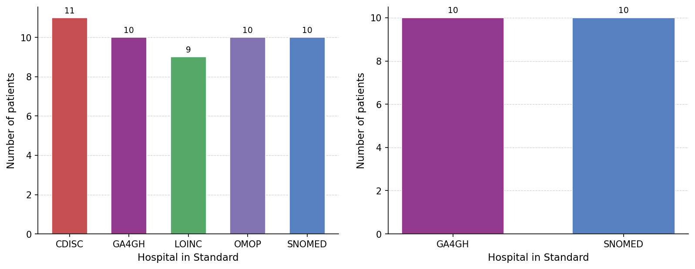
Patient identification across standards
Find All Patients with FemaleSex — across every hospital
SPARQL
Patient | Values | Sourcetype | HRIOMatches
Patient_CDISC_004 | FEMALE | https://evsexplore.semantics.cancer.gov/evsexplore/concept/ncit/C16576 | FemaleSex
Patient_CDISC_007 | F | https://evsexplore.semantics.cancer.gov/evsexplore/concept/ncit/C16576 | FemaleSex
Patient_GA4GH_004 | XX | https://data.health-ri.nl/id/ga4gh-phenopacket-schema/xx | KaryotypicFemaleSex
Patient_LOINC_010 | LA3-6 | https://loinc.org/LA3-6 | FemaleSex | SexAtBirthFemaleSex
Patient_OMOP_012 | female | https://data.health-ri.nl/id/omop/female | FemaleSex
Patient_SNOMED_015 | Female (finding) | http://snomed.info/id/248152002 | KaryotypicFemaleSex
.... | ... |  | ….
SELECT ?patient ?values ?hrioMatches
WHERE {
?patient ex:hospital ?hospital .
?hospital ex:standard ?standard .
?patient ?pred ?node .
?node a ?sourceType .
?node rdf:value ?value .
?mapping owl:annotatedSource ?sourceType ;
owl:annotatedTarget ?hrioConcept ;
owl:annotatedProperty ?rel .
FILTER(?rel IN (hriv:hasExactMeaning, hriv:hasNarrowerMeaningThan))
?hrioConcept rdfs:subClassOf* hrio:FemaleSex .
}
GROUP BY ?patient ?standard
→ Replace hrio:FemaleSex with any HRIO concept
Key insight: One query. Six different vocabularies through HRIO.

Slide 26
Patient identification across standards
Find All Patients with KaryotypicFemaleSex — across every hospital
SPARQL
Patient | Values | Sourcetype | HRIOMatches
Patient_GA4GH_004 | XX | https://data.health-ri.nl/id/ga4gh-phenopacket-schema/xx | KaryotypicFemaleSex
Patient_GA4GH_007 | XX | https://data.health-ri.nl/id/ga4gh-phenopacket-schema/xx | KaryotypicFemaleSex
Patient_GA4GH_011 | XX | https://data.health-ri.nl/id/ga4gh-phenopacket-schema/xx | KaryotypicFemaleSex
Patient_SNOMED_001 | Female (finding) | http://snomed.info/id/248152002 | KaryotypicFemaleSex
Patient_SNOMED_07 | Female (finding) | http://snomed.info/id/248152002 | KaryotypicFemaleSex
Patient_SNOMED_015 | Female (finding) | http://snomed.info/id/248152002 | KaryotypicFemaleSex
.... | ... |  | ….
SELECT ?patient ?values ?hrioMatches
WHERE {
?patient ex:hospital ?hospital .
?hospital ex:standard ?standard .
?patient ?pred ?node .
?node a ?sourceType .
?node rdf:value ?value .
?mapping owl:annotatedSource ?sourceType ;
owl:annotatedTarget ?hrioConcept ;
owl:annotatedProperty ?rel .
FILTER(?rel IN (hriv:hasExactMeaning, hriv:hasNarrowerMeaningThan))
?hrioConcept rdfs:subClassOf* hrio:KaryotopicFemaleSex .
}
GROUP BY ?patient ?standard
→ Replace hrio:KaryotopicFemaleSex with any HRIO concept
Key insight: One query. Six different vocabularies through HRIO.

Slide 27
Result of Amir’s Workflow
Scenario 1: Clarify Meanings Before Reuse
Scenario 2: Identify the datasets that represent the right meaning
Result:
Amir could move from label-based guessing to query-supported reuse decisions, using meanings, mappings, and inferred knowledge to query relevant variables, compare concepts, and assess which ones align, partially overlap, or should not be reused together.
Scenario 3: Use Mappings to Connect Data and Infer Reuse Knowledge
Scenario 4: Query Semantic Knowledge Across Variables and Meanings

Slide 28

Thank you!
https://w3id.org/
health-ri/semantic-interoperability
Pedro Paulo F. Barcelos, Niek van Ulzen, Reinier Groeneveld,
Ana Konrad, Douwe Spaanderman, and Shuxin Zhang

Slide 29
Similar Labels Can Mislead Reuse
(Biological) Sex: Male
Patient-002
(Biological) Sex: Male
Patient-001
(Social) Gender: Male
(Social) Gender: Female (Trans)
Patient-003
(Biological) Sex: Female
(Social) Gender: Non-binary
Scenario 1
Notes:
We continue with a simple example that shows why similar labels can mislead reuse.
Here we see three patients. Each patient has information about biological sex and social gender.
The important point is that these are not the same variable.
Patient 1 has male biological sex and male social gender. Patient 2 has male biological sex, but their social gender is recorded as female. Patient 3 has female biological sex and non-binary social gender.

Slide 30
Similar Labels Can Mislead Reuse
Patient-001
(Biological) Sex: Male
(Social) Gender: Male
Patient-002
(Biological) Sex: Male
(Social) Gender: Female (Trans)
Patient-003
(Biological) Sex: Female
(Social) Gender: Non-binary
Identify patients with male biological sex for a study where biological sex is the intended criterion.
Retrieve patients where Gender = Male.
Returns Patient-001 only, incorrectly missing Patient-002, whose biological sex is male but gender is female/trans.
Identify patients who socially identify as male for gender-based analysis.
Retrieve patients where Sex = Male.
Returns Patient-001 and Patient-002, incorrectly including Patient-002, whose gender is female/trans.
Identify patients with female gender for a study about social gender identity.
Retrieve patients where Sex = Female.
Returns Patient-003 only, incorrectly missing Patient-002, whose gender is female.
Scenario 1
Notes:
This slide shows what can go wrong if Amir uses the wrong variable for his research question.
If the intended criterion is biological sex, but Amir filters on gender equals male, he retrieves only Patient 1. He misses Patient 2, whose biological sex is male.
If the intended criterion is social gender, and Amir wants patients who socially identify as male, filtering on sex equals male retrieves Patient 1 and Patient 2. But Patient 2 should not be included for that question, because their social gender is recorded as female, with trans indicated.
And if Amir wants patients with female gender, but filters on sex equals female, he retrieves only Patient 3. He misses Patient 2.
So the issue is not simply a technical filtering mistake. It is a semantic mistake: the query uses a variable whose meaning does not match the study criterion.

Slide 31
Distinct Concepts Within Sex and Gender
Sex and Gender are not single, uniform meanings; each branches into multiple interpretations/specializations.
Before comparing dataset variables, we must distinguish which specialization a concept actually refers to.
Sex/Gender
care-sm:Sex
("Biological sex"@en)
(Biological) Sex
(Social) Gender
loinc:107454-1
("Administrative gender"@en)
Sex at Birth
Self-Identified Gender
Administrative Gender
…
openehr:legal-gender
("Legal gender"@en)
Karyotypical Sex
Legal Gender
…
Scenario 1
Notes:
This slide shows that sex and gender are not single, uniform meanings. They branch into several related but different concepts.
For example, biological sex, sex at birth, and karyotypical sex are not automatically the same thing. In the same way, social gender, self-identified gender, administrative gender, and legal gender refer to different kinds of information.
So, before Amir compares variables across datasets, he needs to understand which specific meaning each variable refers to, and how those meanings relate to one another.

Slide 32
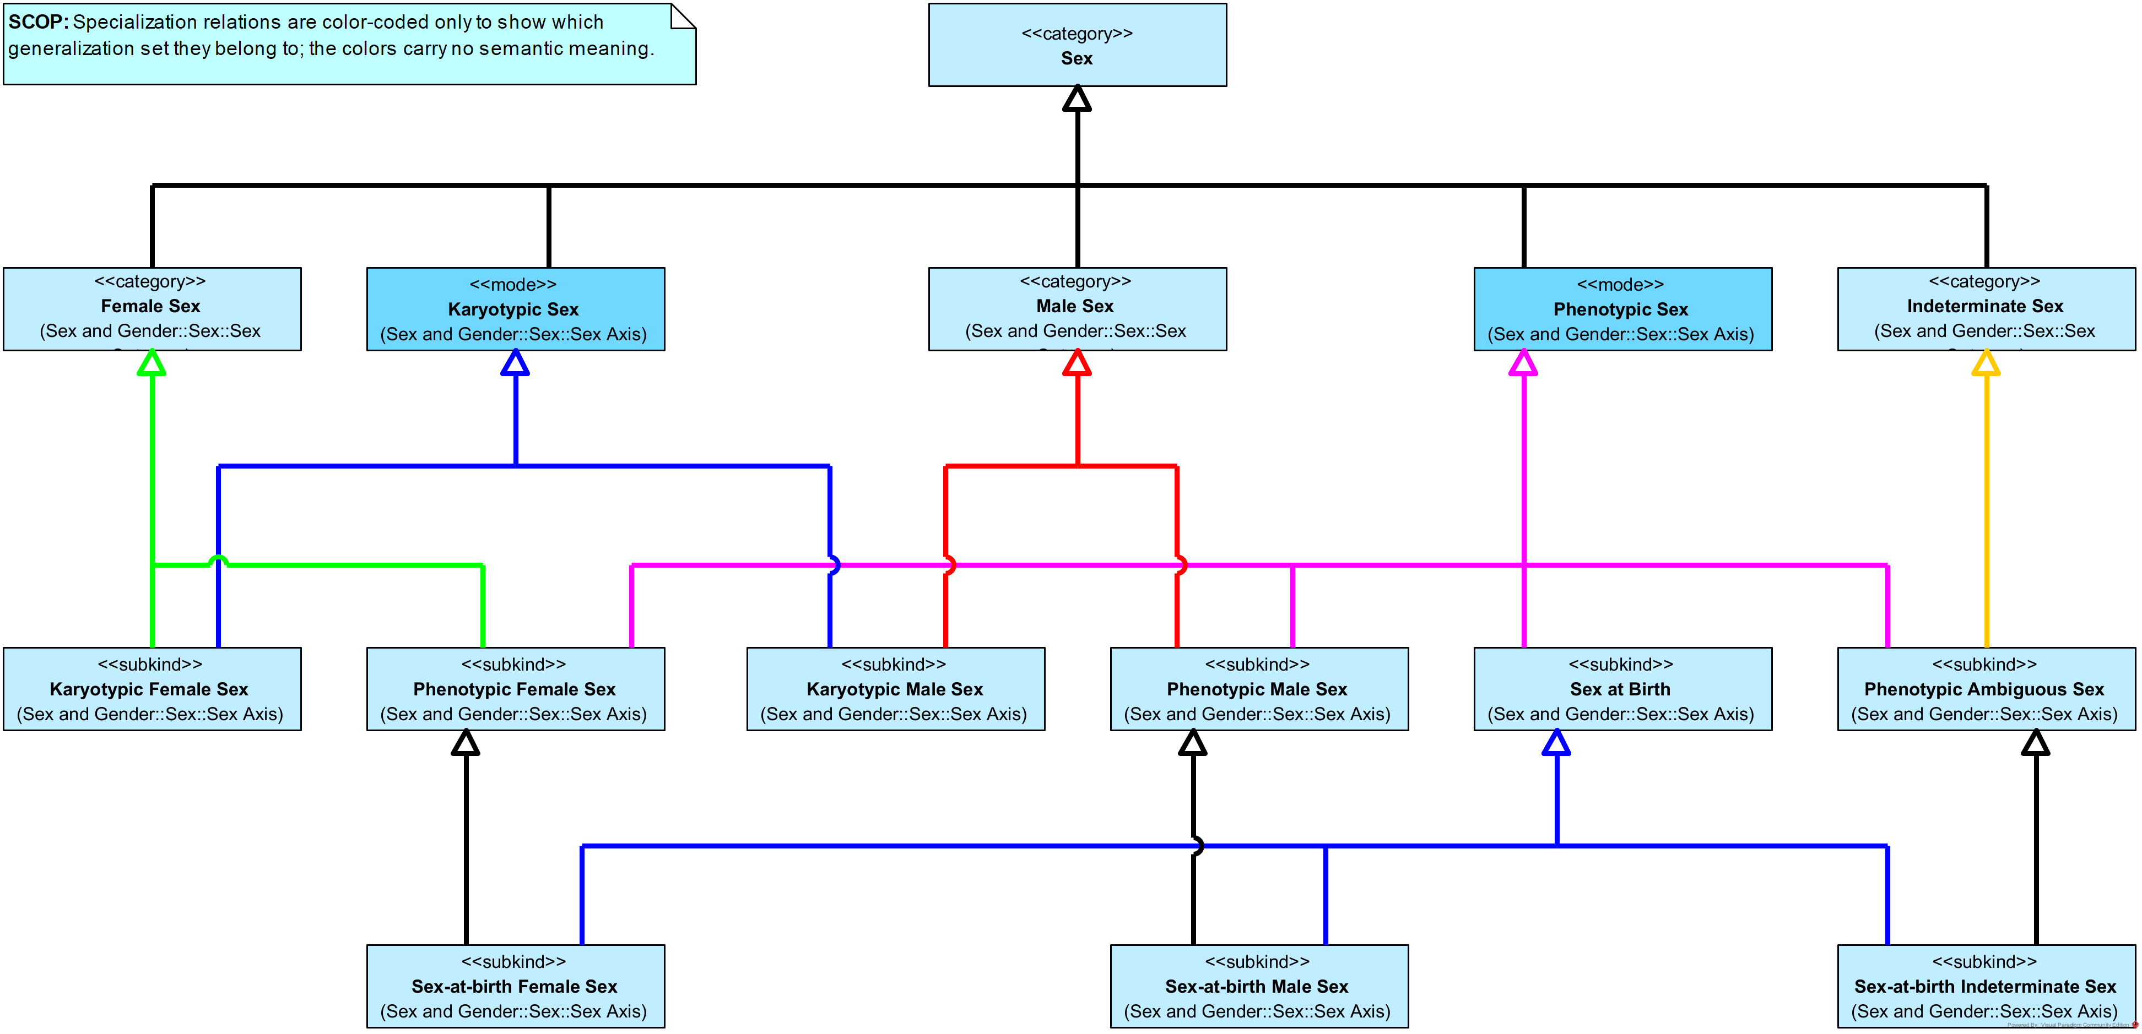
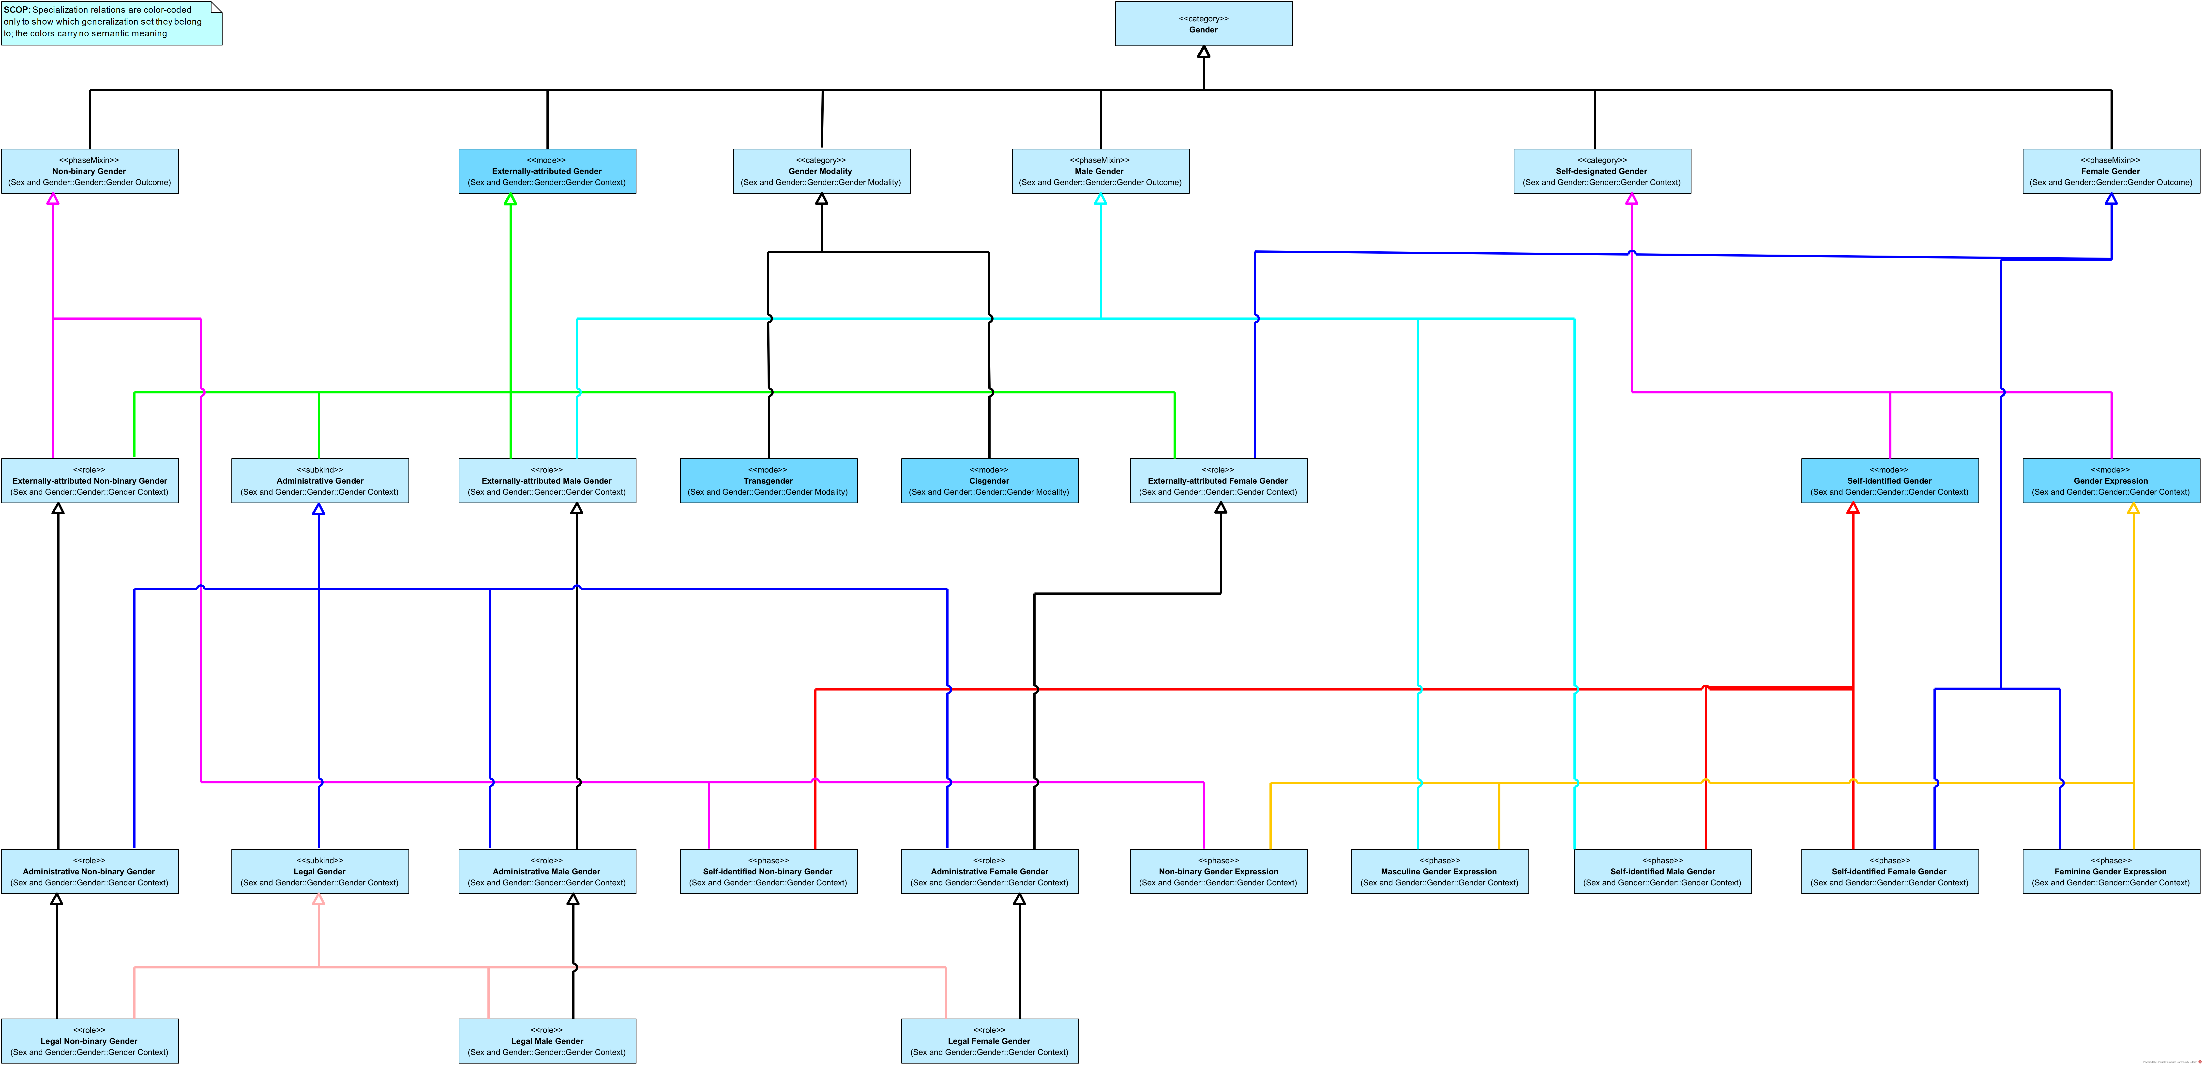
HRIO Taxonomies for Sex and Gender
Sex
Gender
Scenario 1
Notes:
Here we see the HRIO taxonomies for sex and gender.
The details of the diagrams are not the main focus for the audience at this point. What this slide shows is that HRIO organizes these meanings into clear taxonomies.
Instead of treating all sex- and gender-related variables as one flat group, HRIO separates them into precise categories and makes their distinctions explicit.
This gives Amir a reference structure for asking better questions. For example, instead of simply asking for “gender,” he can now see that there are different kinds of gender-related concepts, connected in different ways, and identify which one best fits his study.

Slide 33

Variables Map to Distinct Meanings
care-sm:Sex
“Biological sex”@en
hri-openehr:legal-gender
“Legal gender”@en
loinc:107454-1
“Administrative gender”@en
HRIO’s Sex
HRIO’s Legal Gender
HRIO’s Administrative Gender
Scenario 1
Notes:
With these distinctions in place, Amir can use HRIO to identify the intended meaning of each dataset variable.
Here, the Care-SM variable, labeled Biological sex, is linked to the HRIO’s Sex concept. The openEHR-based variable, labeled Legal gender, is linked to the HRIO’s Legal Gender concept. And the LOINC variable, labeled Administrative gender, is linked to the HRIO’s Administrative Gender concept.
The key point is that each variable keeps its original representation, but its meaning becomes explicit.

Slide 34
When are two datasets interoperable?
When can two datasets be safely reused together?
When their relevant columns implement the same standard concept.
However, this works only if (1) the standard concept is well defined, and
(2) the datasets implement it correctly.
C2
C1
C3
Standard Concepts
D1
D2
D3
D4
Dataset Columns
Scenario 2
Notes:
To understand the problem more generally, we start with a simple question: when can two datasets be safely reused together?
At the bottom, we have dataset columns. At the level above, we have standard concepts. A dataset column may implement a concept from a standard.
When the relevant columns from different datasets implement the same standard concept, that shared concept can provide a useful point of alignment.
However, this only works under two important conditions: the standard concept must be well defined, and the datasets must implement it correctly.
So, this model can support interoperability, but only when the shared standard concept is sufficiently precise and reliably used.

Slide 35
When are two datasets interoperable?
Can D1 and D2 be safely reused together?
Without explicit meanings, we can only see interoperability when datasets share the same standard concept.
C2
C1
C3
Standard Concepts
D1
D2
D3
D4
Dataset Columns
Scenario 2
Notes:
The next question is: what happens when two dataset columns do not implement the same standard concept? For example, can D1 and D2 be compared or combined safely?
If both columns point to the same well-defined standard concept, we have visible evidence of alignment. But if that shared concept is missing, indirect, or unclear, then interoperability is harder to assess.
Without explicit meanings, we can only see interoperability when datasets share the same standard concept.

Slide 36
Semantic Interoperability Conditions
We need precise and explicit meanings.
Meanings
M1
M2
If meanings differ, interoperability is not possible.
C2
C1
C3
Standard Concepts
*
D1
D2
D3
D4
Dataset Columns
Scenario 2
Notes:
Now we make the condition for semantic interoperability more explicit.
D1 and D2 may both appear relevant, and their concepts may belong to the same broad area. But once we look at the meanings layer, we see that they point to different meanings.
That difference matters. If the concepts do not share the same meaning, then the variables cannot be safely reused together.
So for Amir, this is a negative result: without shared meaning, these variables should not be treated as interoperable for his study.

Slide 37
Semantic Interoperability Conditions
We need precise and explicit meanings.
Meanings
M1
M2
If meanings differ, interoperability is not possible.
If the concepts share the same meaning, interoperability is possible.
C2
C1
C3
Standard Concepts
*
D1
D2
D3
D4
Dataset Columns
Scenario 2
Notes:
Now we see the positive case.
D1 and D2 are connected to concepts that share the same meaning. This gives us a semantic basis for comparing or reusing them together.
However, semantic compatibility is only one part of interoperability. It is necessary, but not sufficient. Other aspects still matter, such as structure, values, formats, and implementation details.
So the conclusion here is cautious but positive: D1 and D2 meet the necessary condition for interoperability.

Slide 38
From Mappings to Inferred Knowledge
Legend
hasMeaning
narrowerThan
Meanings
aligns
cannotAlign
partiallyAlign
Standard Concepts

Slide 39
Cross-Standard Concept Coverage
Which HRIO concepts are covered per standard — and by how many patients?
SPARQL
Standard | Sourcetype | HRIOConcept | PatientsCount
CDISC SDTM (NCIt) | ncit:C16576 | hrio:Female | 11
GA4GH Phenopacket Schema 2.0 | hri-ga4gh-phenopacket-schema:xy | hrio:KaryotypicMaleSex | 8
LOINC | loinc:LA22879-3 | hrio:SelfIdentifiedFemaleGender | 9
SNOMED CT | snomed:248153007 | hrio:KaryotypicMaleSex | 9
openEHR (Gender archetype v2) | hri-oeh:legal-gender | hrio:LegalGender | 20
openEHR (Gender archetype v2) | hri-oeh:preferred-pronoun | hrio:PreferredPronoun | 20
.... | ... |  | ….
SELECT ?standard ?sourceType ?hrioConcept
(COUNT(DISTINCT ?patient) AS ?patientCount)
WHERE {
?patient ex:hospital ?hospital .
?hospital ex:standard ?standard .
?patient ?pred ?node .
?node a ?sourceType .
?mapping owl:annotatedSource ?sourceType ;
owl:annotatedTarget ?hrioConcept ;
owl:annotatedProperty ?rel .
FILTER(?rel IN (hriv:hasExactMeaning, hriv:hasNarrowerMeaningThan))
}
GROUP BY ?standard ?sourceType ?hrioConcept
Key insight: 6 standards. 44 source types. 47 HRIO concepts. One mapping layer.

